Slide 4
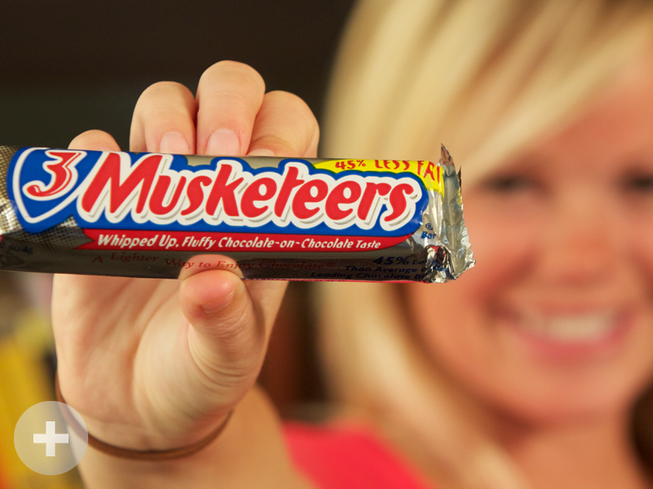

Slide 30
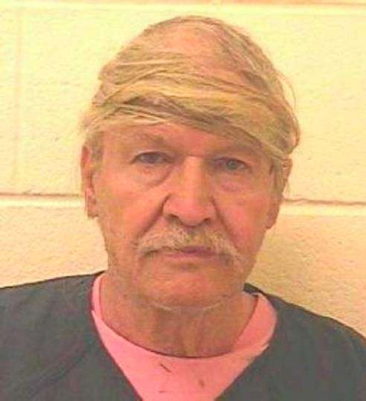

Slide 31
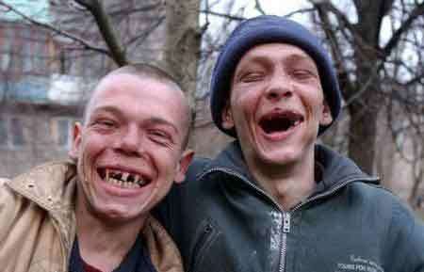

Slide 33
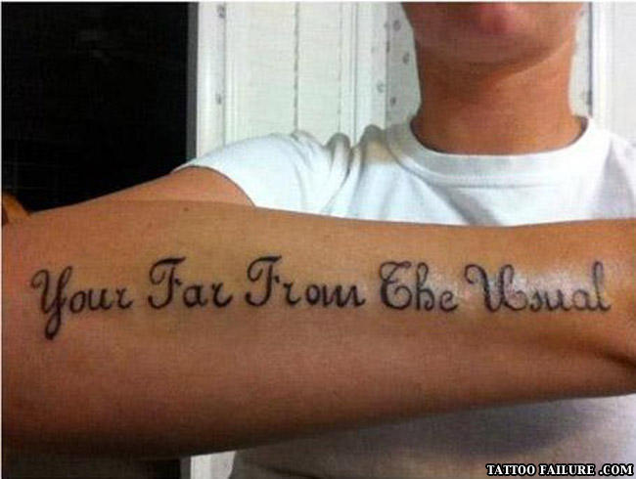

Slide 34
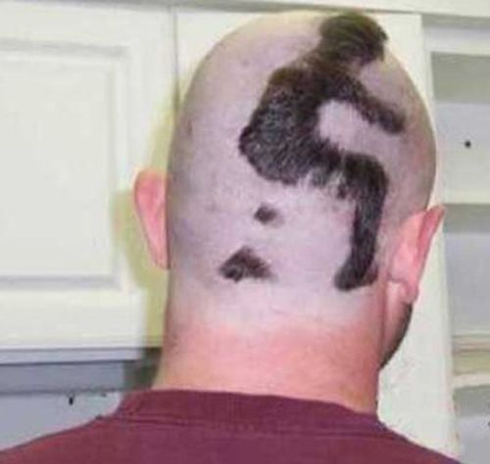

Slide 35
DOES JESUS WANT FANS
OR
FOLLOWERS?

Slide 36
Jesus wants followers who don’t measure themselves against others to see how they are doing.

Slide 37
Jesus wants followers who don’t just try to look and act Christian while their heart stays unchanged.

Slide 38
Jesus wants followers who will deny themselves
pick up their cross and follow Him.

Slide 39
DIAGNOSING FANDOM
QUESTION #1
Have you made a decision for Jesus, or have you committed to Jesus?

Slide 40
DIAGNOSING FANDOM
QUESTION #2
Do you just know about Jesus, or do you really know Him?

Slide 41
DIAGNOSING FANDOM
QUESTION #3
Is Jesus one of many, or is He your one and only?

Slide 42
DIAGNOSING FANDOM
QUESTION #4
Are you more focused
on the outside
than the inside?

Slide 44
“Everything they do is for show…What sorrow awaits you teachers of religious law and you Pharisees. Hypocrites! For you are like whitewashed tombs—beautiful on
the outside but filled on the inside
with dead people’s bones and all
sorts of impurity.”

Slide 45
“Outwardly you look like
righteous people, but
inwardly your hearts are filled
with hypocrisy and lawlessness.”
~ Matthew 27:5, 27,28

Slide 46
DIAGNOSING FANDOM
QUESTION #5
Are you a self-empowered fan or a Spirit-filled follower?

Slide 47
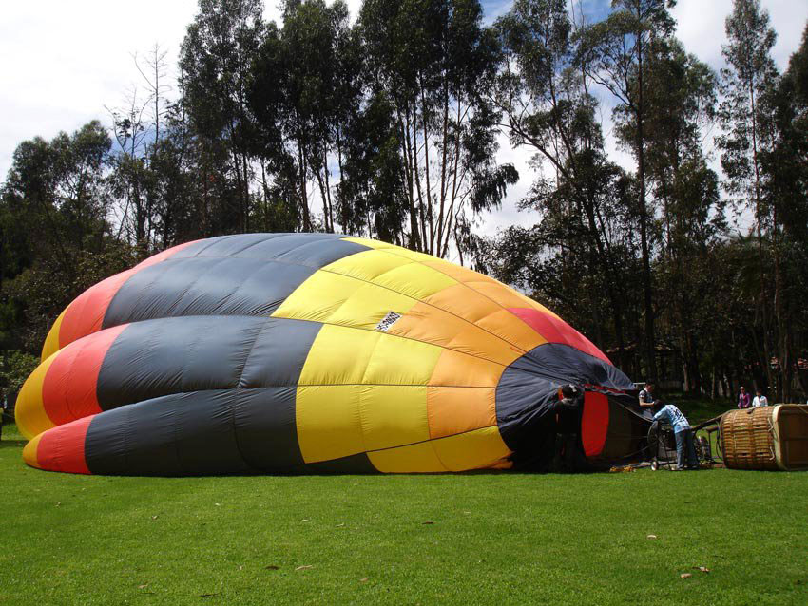

Slide 49
The Spirit of God, who raised Jesus from the dead, lives in you. ~ Rom. 8:11
Now all glory to God, who is able, through his mighty power at work within us, to accomplish infinitely more than we might ask or think.
~ Ephesians 3:20

Slide 50
DIAGNOSING FANDOM
QUESTION #6
Does your life reflect
what you say you believe about Jesus?

Slide 51
